Slide 1

Presentation for the Front-end Part
3 mins per group

Slide 2



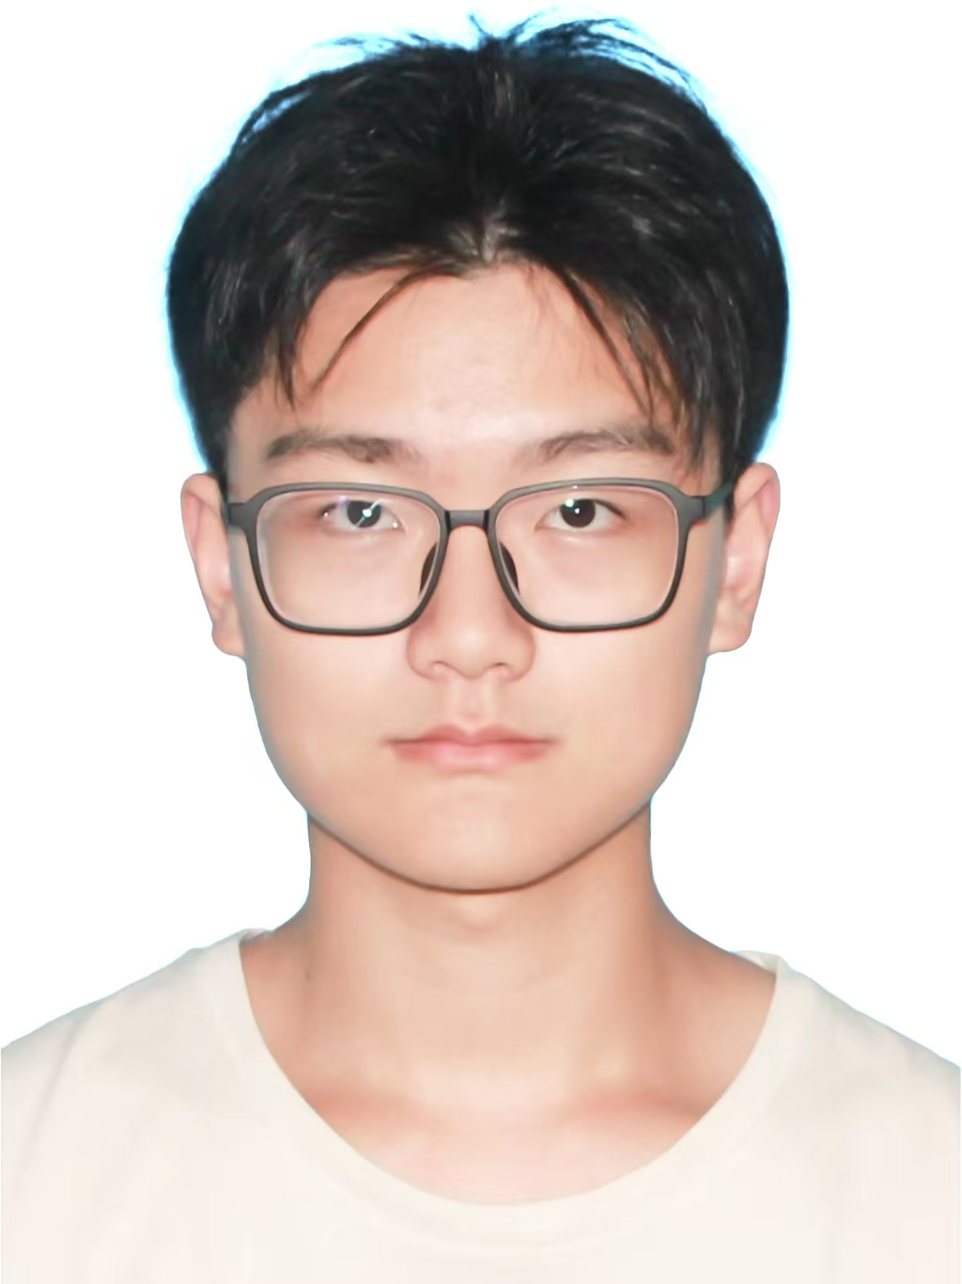
1. Member
1. ZhangGe 20232062
2. WangYuTao 20232057
3. TangZiYu 20232046
ZhangGe
TangZiYu
WangYuTao

Slide 3
2. Project name/Project Goal
Project name: Social Anti-Fake News System
Project goal:To build a platform where users can identify, vote, and discuss the authenticity of news, focusing on fake news in areas like sports, music, games, etc.

Slide 4
3. Features
· F1: News list with filtering (All / Fake / Not Fake)
· F2: News detail page with voting and comments
· F3: Real-time voting results (Fake / Not Fake)
· F4: Commenting with text or image links
· F5: Pagination with customizable items per page
…

Slide 5
4. Tech Stack
· Frontend: React / Vue.js
· State Management: Context API / Redux
· Deployment: Vercel
· Data: Mock data for testing

Slide 6
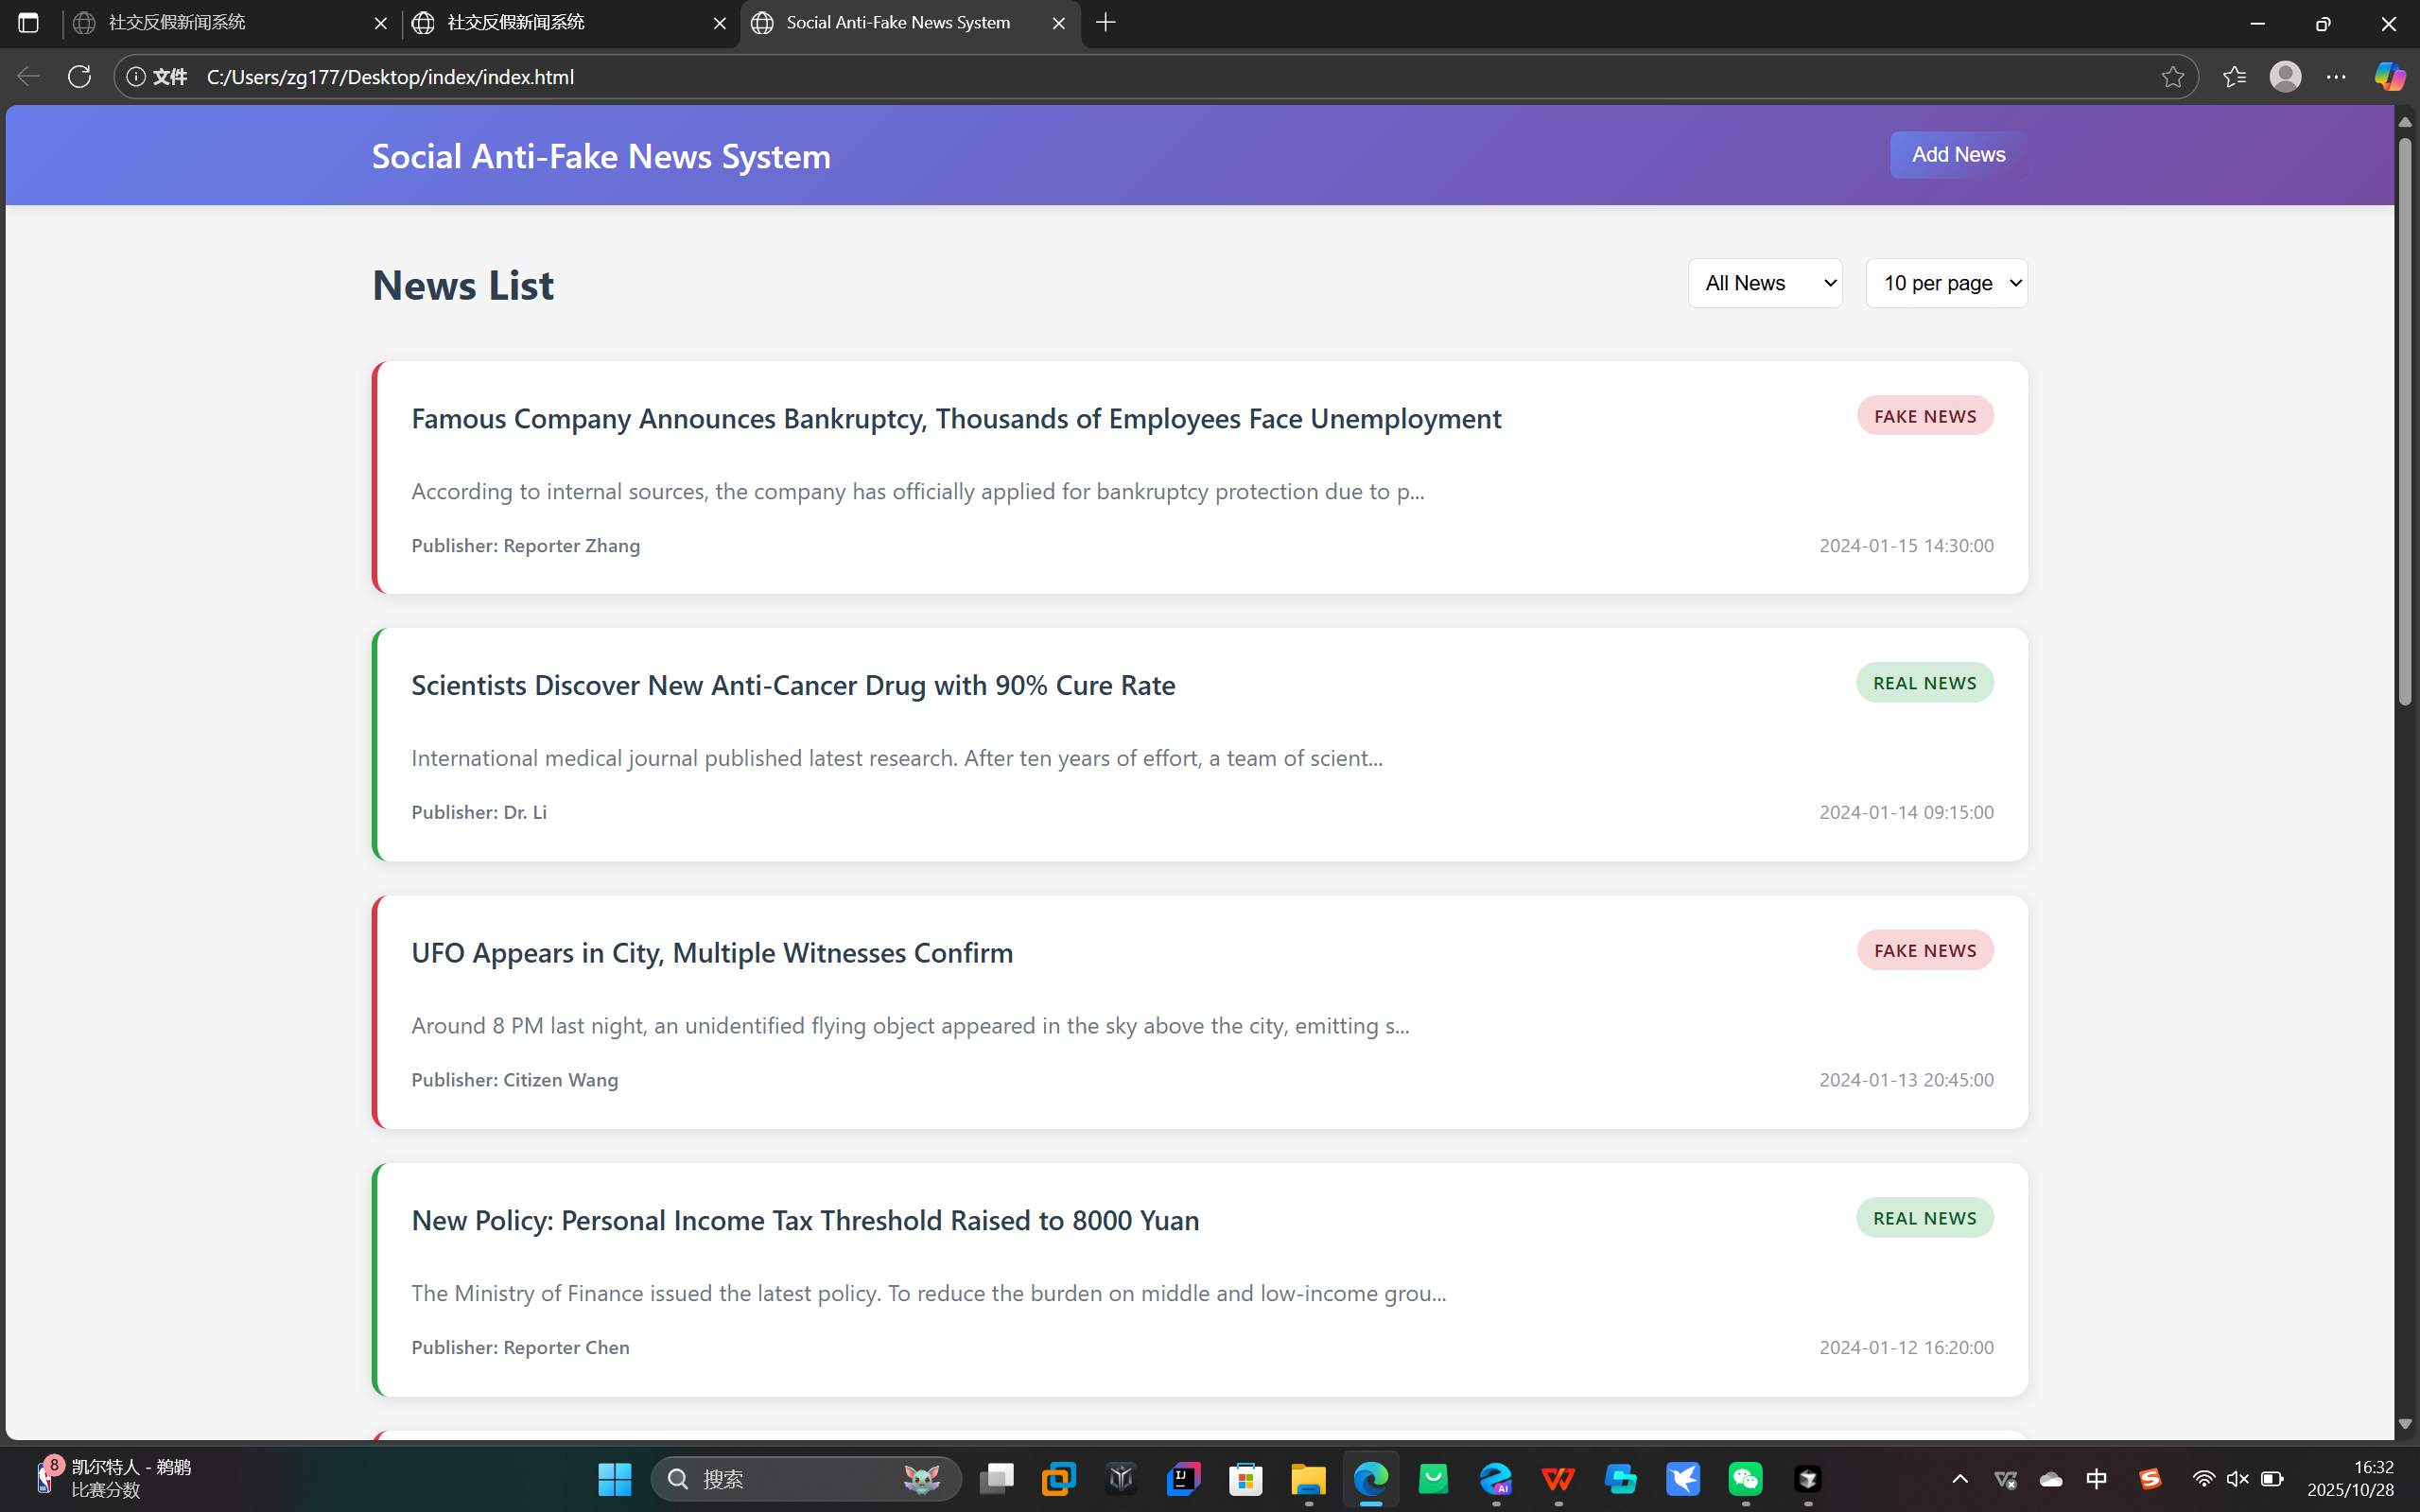
5. Home page
- list of news, filter (all / fake / not fake), pagination, and how many items per page?
<<show your design here>>

Slide 7
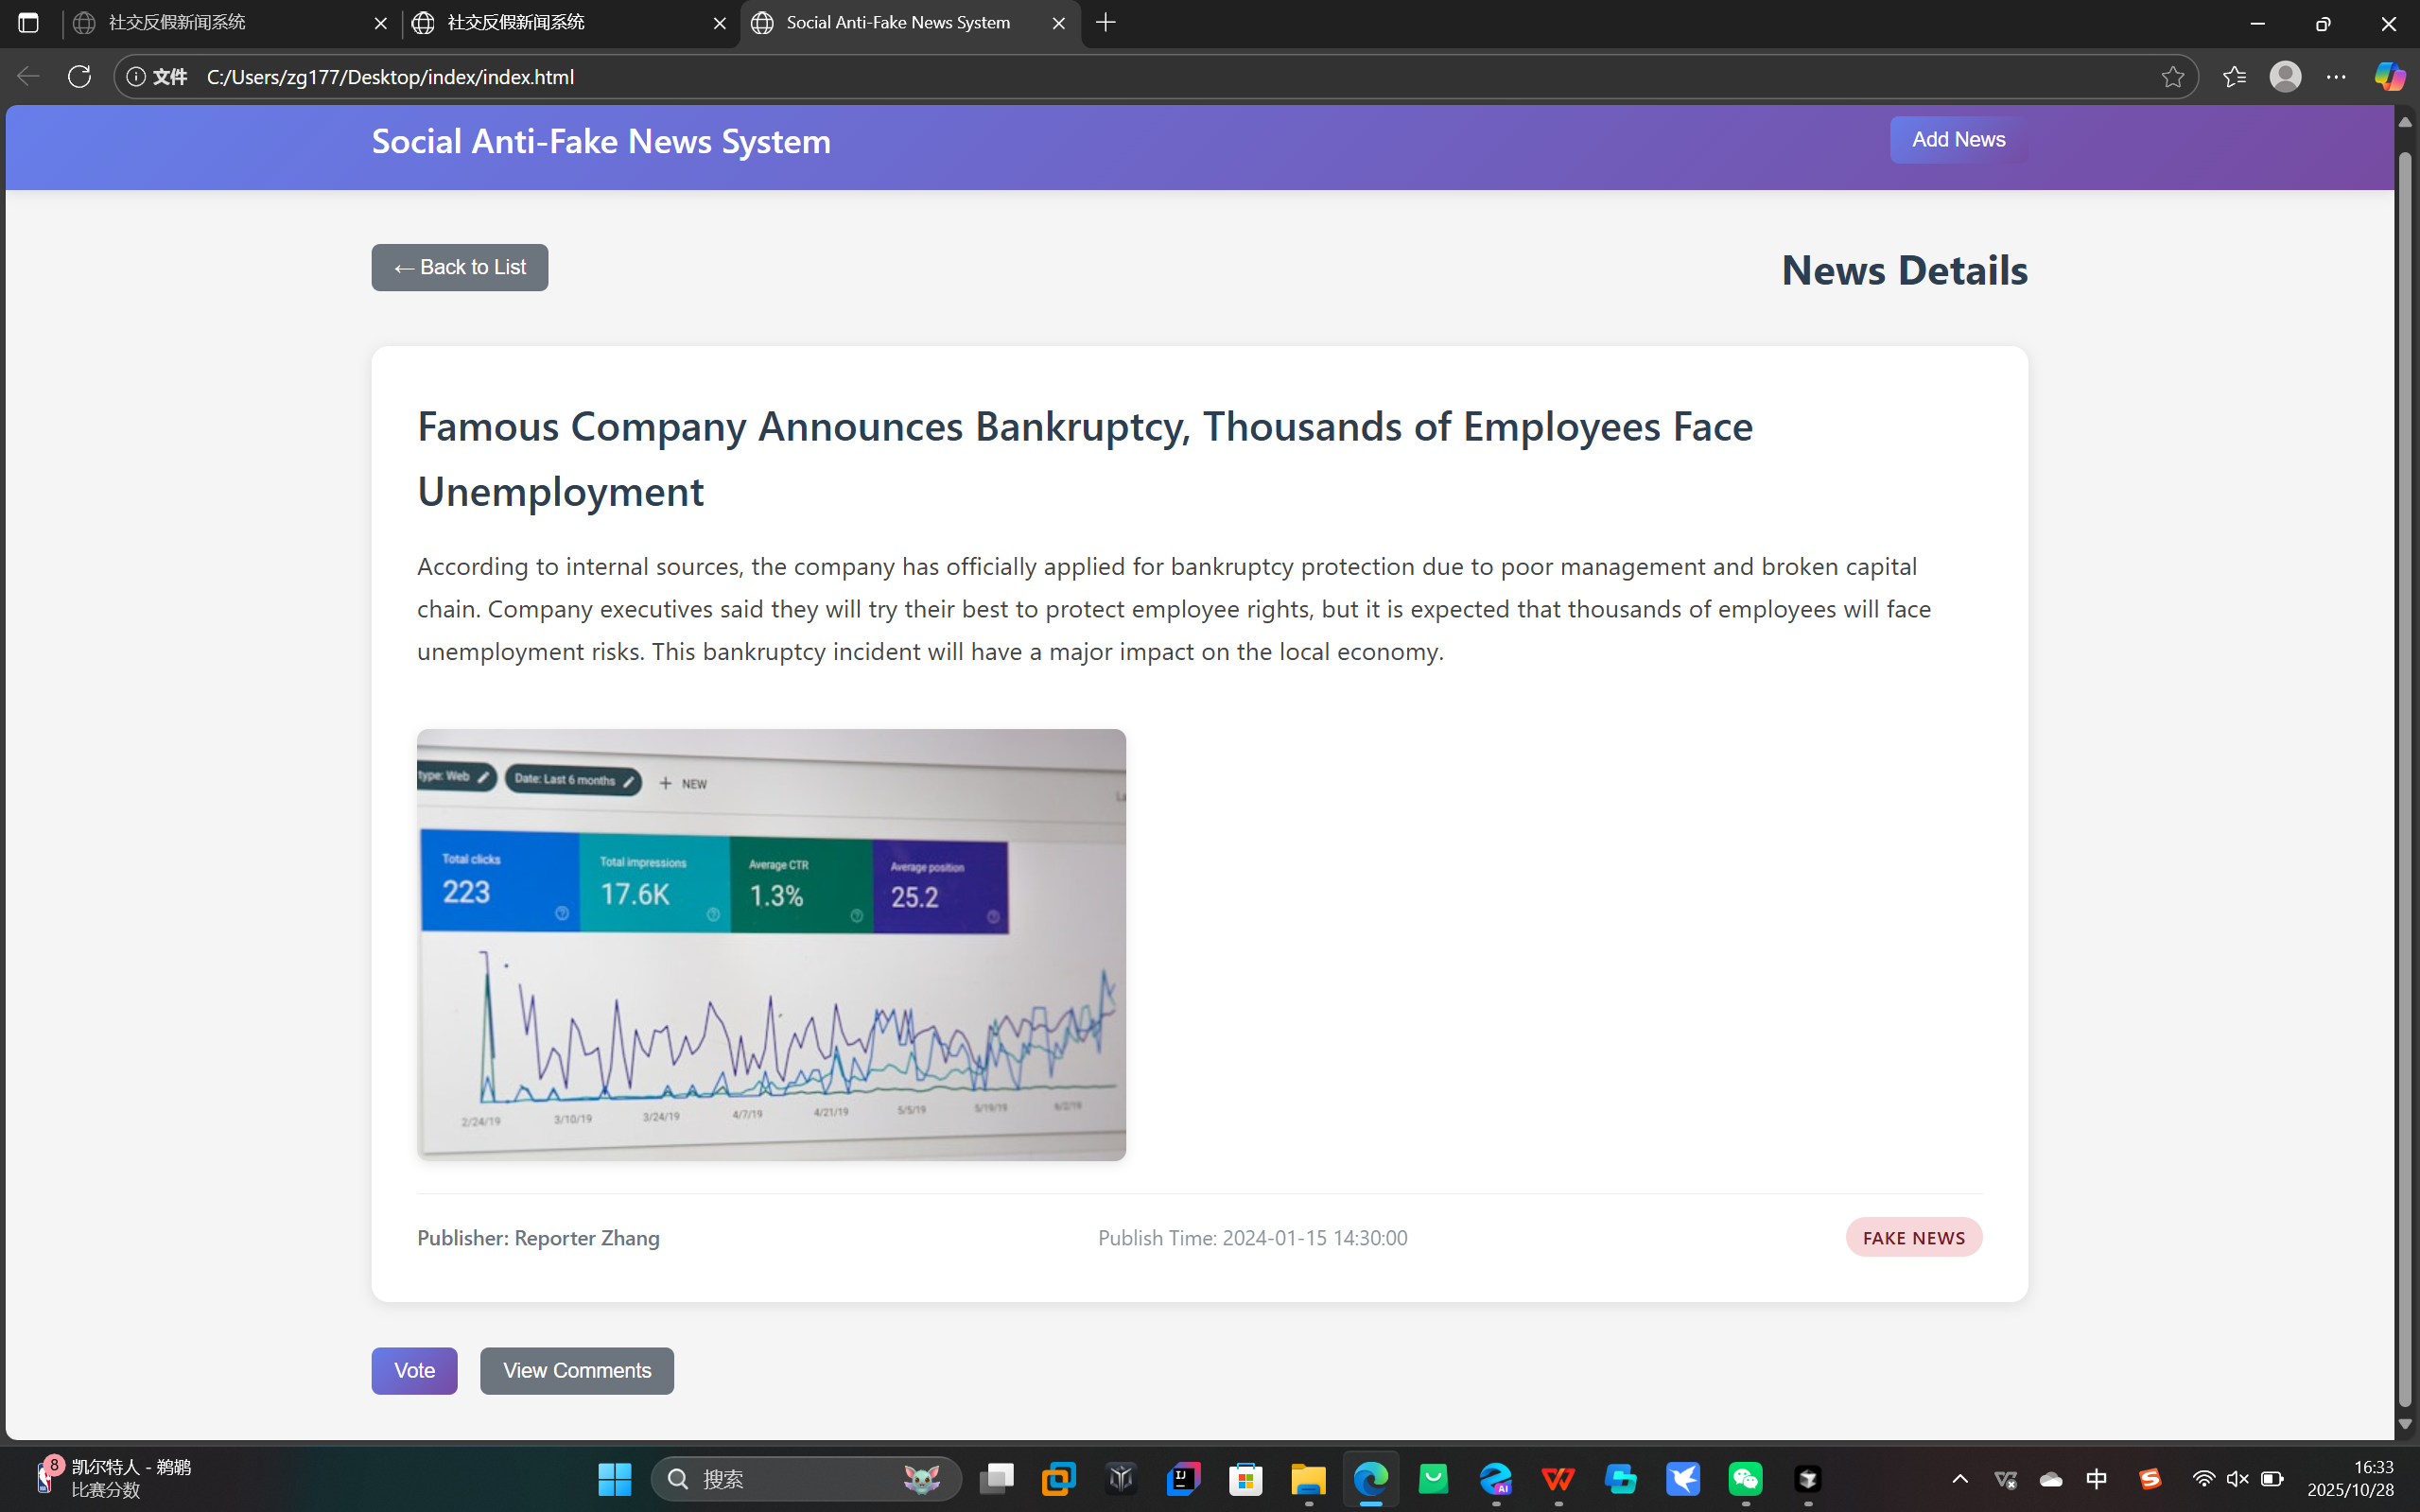
6. News Details Page
- Click on one news item to show: topic, full details, reporter, date/time, image (URL) - Show comment section and voting results (fake / not fake)
<<show your design here>>

Slide 8
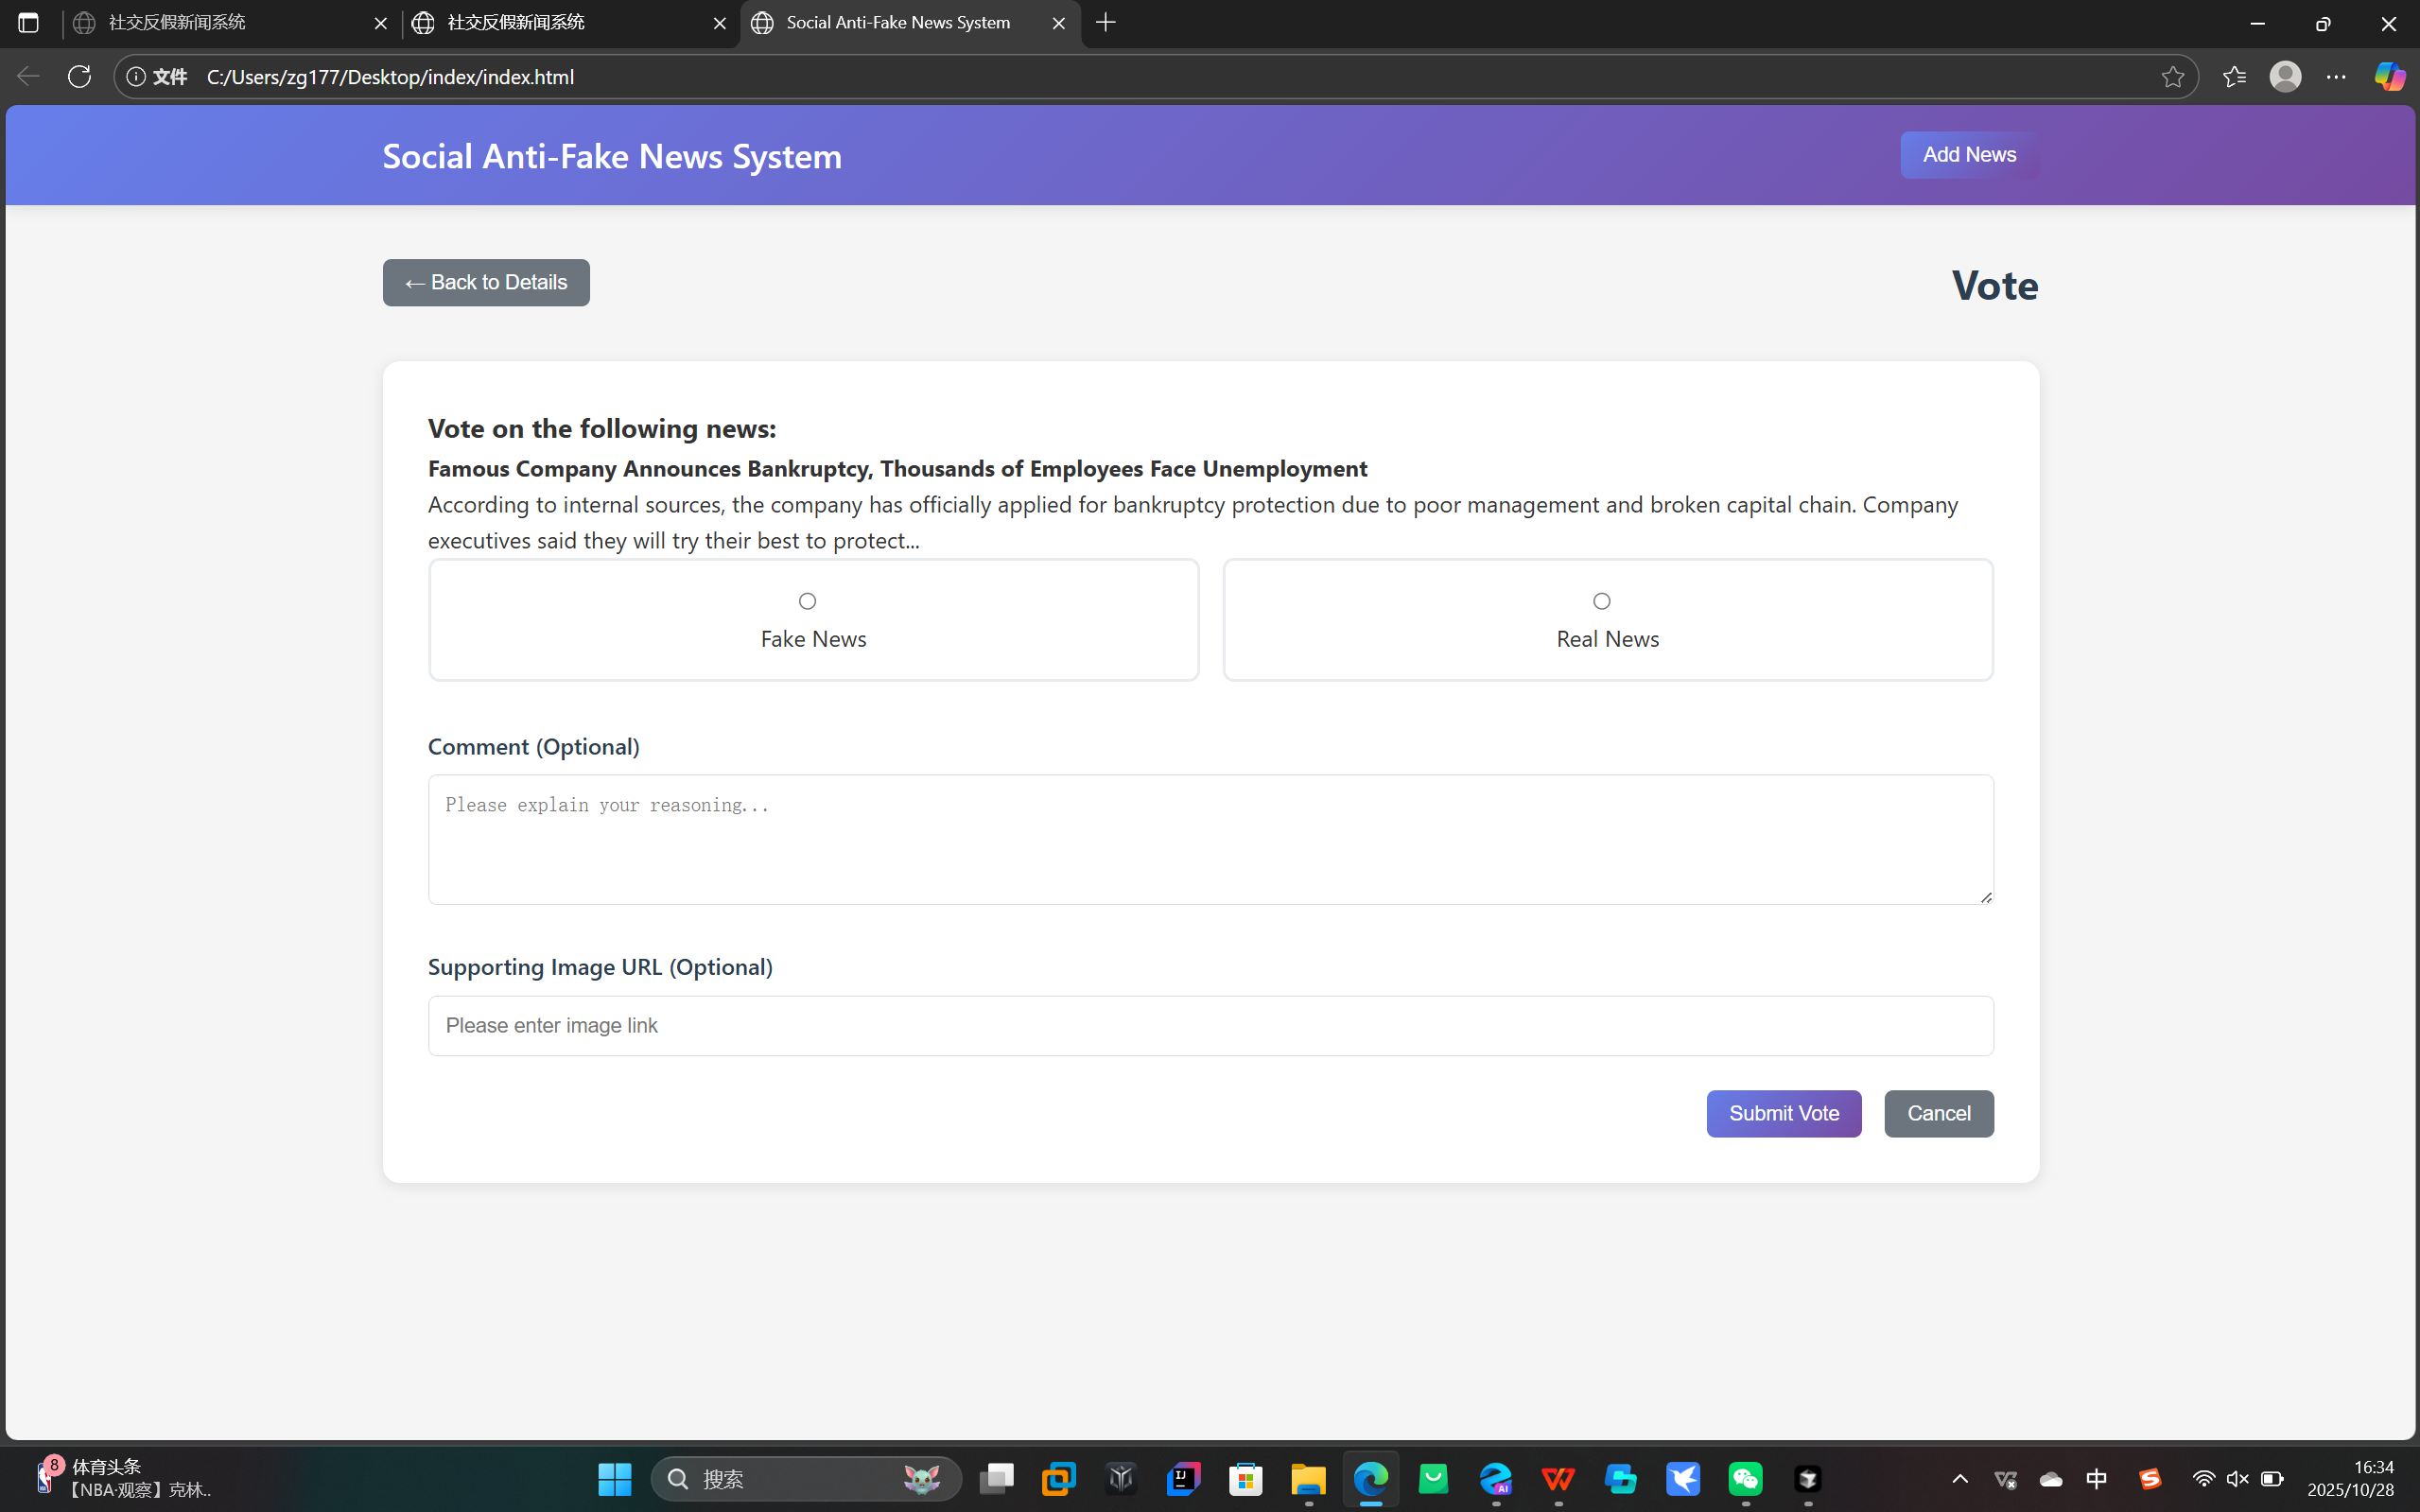
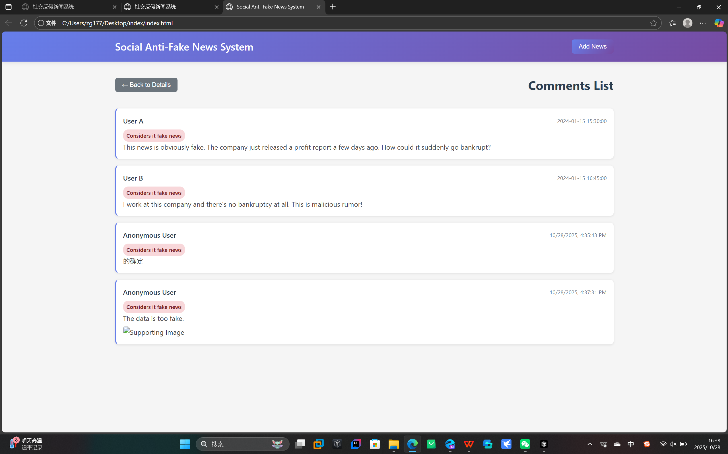
7. Vote & Comment Feature
- Demonstrate voting and adding a comment or image link - Show that new data appears in the comment list immediately
<<show your design here>>

Slide 9
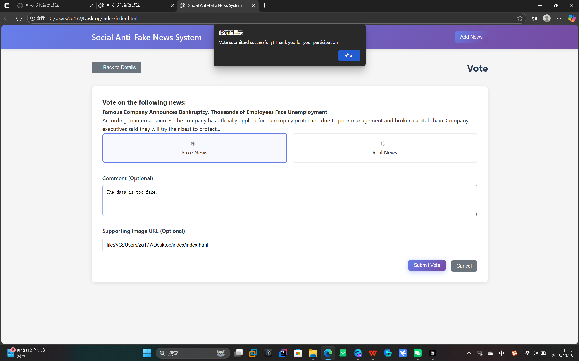
8. Deployment with Versel
- Mention mock data used for testing and pagination implemented
<<show your design here>>

Slide 10
Submission
Record 3-5 mins presentation and submit to Moodle (Only one people in the team will submit in Moodle, you can submit to any section)
Submission Deadline : 9th November 11.59 pm

Slide 11
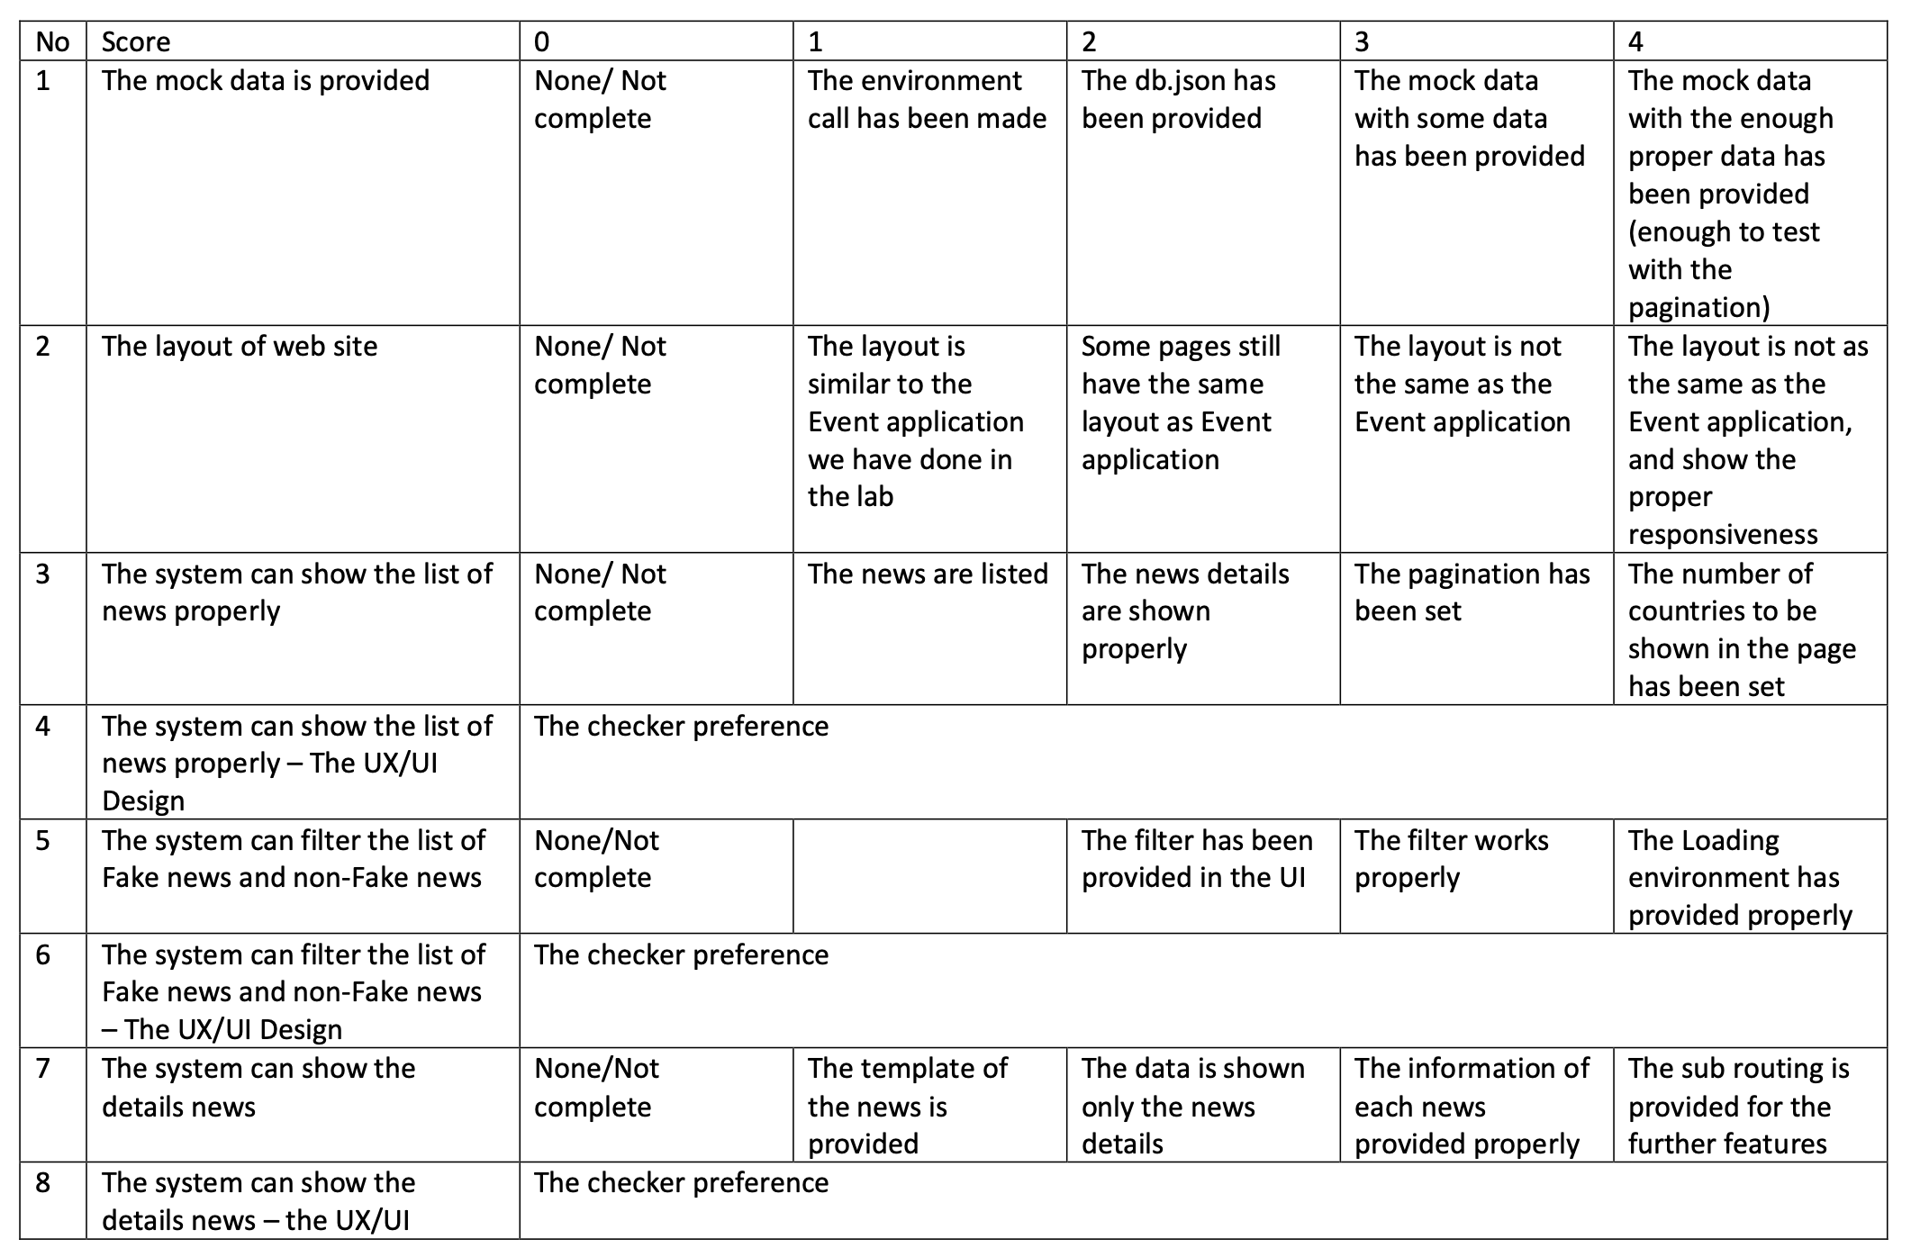

Slide 12
